Slide 1
Customer Attrition

Slide 2

Project Background
Credit card services is one of the major forms of payment in the retail industry today. In a competitive market and other forms payment on the rise, customer attrition is one of the problems banks are facing. In this project, we will analyze customer attrition using a dataset obtained from a hypothetical bank. We aim to improve churn rate by predicting customers who are likely to churn from the existing ones.
Notes:
Selected topic and Reason

Slide 3

The Dataset
The dataset that will be used for this analysis project was obtained from https://leaps.analyttica.com/home through Kaggle.com. The dataset contains over 10,000 customer demographics such as age, salary, marital status, credit card limit, category, etc.

Slide 4

Project Goals
Analyze and find demographic trends from attrited customers.
Create a machine learning model that can predict who are likely to churn from existing customers.

Slide 5

Exploratory Data Analysis
Our group will perform exploratory data analysis using the parameters contained in the dataset. Specifically, we will use charts and graphs such as boxplot and pie charts to represent the distribution of customers using different parameters.

Slide 6
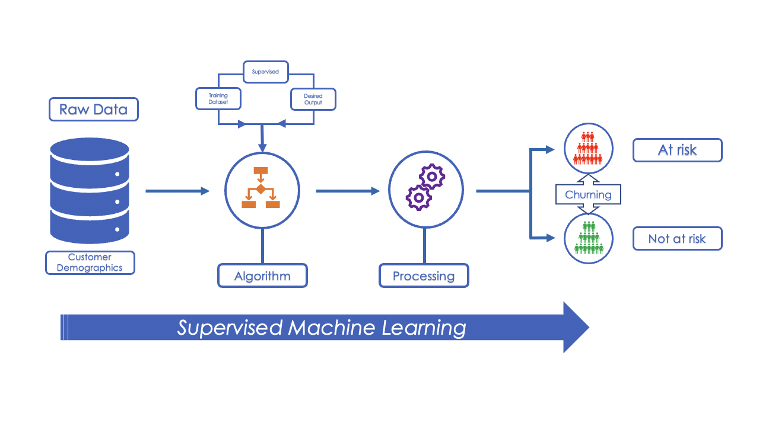
Analysis using Supervised
Machine Learning
The analysis phase of this project will involve supervised machine learning. We will use two supervised machine learning models, Logistic Regression and Random Oversampling, to predict churn rate and customers who are likely to churn.

Slide 7

Project Dashboard

Slide 8

Tableau for Visualization
The visualization piece of the project will use Tableau to create the final dashboard. The exploratory data analysis as well as the findings of machine learning analysis will be presented in various forms of simple and interactive graphs,

Slide 9

Interactive Element of the Dashboard
To make the presentation interactive, we will use Tableau’s story feature to create the story that we want to share about the dataset.

